Slide 1



Roosevelt Forest Tree Cover Type Prediction
Kevin McPherson
Flatiron School Module 3 Project
March 30, 2020

Slide 2
Roosevelt National Forest (RNF)
Over 800,000 acres of total area
Separated into two different ranger districts, which makes the park difficult to manage
Natural resource management is important part of park rangers’ job at RNF
General purpose of project: Providing a way for park rangers to know how to spot cover type to make the conservation and prevention parts of their job easier

Slide 3

Introduction to the Data
Data is provided by the UCI Machine Learning Repository
Each row in the set represents a 30 x 30 sq. meter patch of forest
Cartographic features, rather than remote features (i.e., features from a satellite)
Heavy Spruce/Fir and Lodgepole Pine forests

Slide 4
Some Important Features of the Data
Descriptions for all the features in the dataset are as follows:
Elevation - Elevation in meters
Aspect - Aspect in degrees azimuth
Slope - Slope in degrees
Wilderness Area (4 binary columns, 0 = absence or 1 = presence) - Wilderness area designation
Soil Type (40 binary columns, 0 = absence or 1 = presence) - Soil Type designation
Target Variable: Cover Type (7 types, integers 1 to 7) - Forest Cover Type designation
Aspect and Cover Type illustration

Slide 5

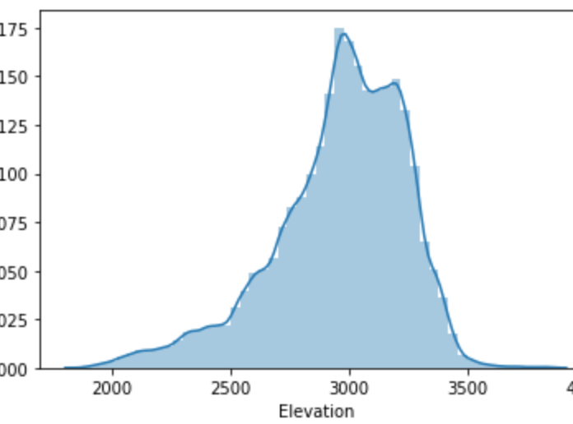
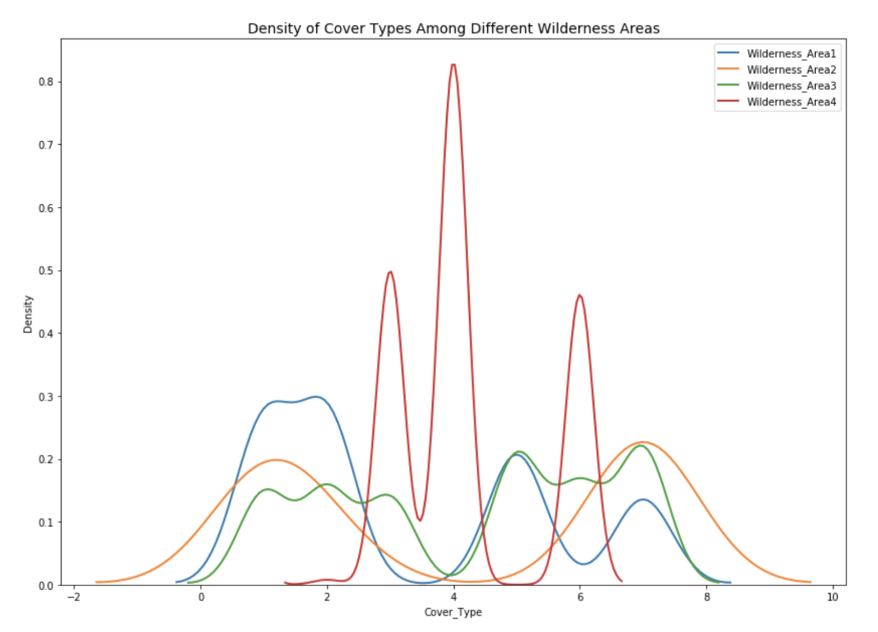
Graphical Representation of the Data

Slide 6
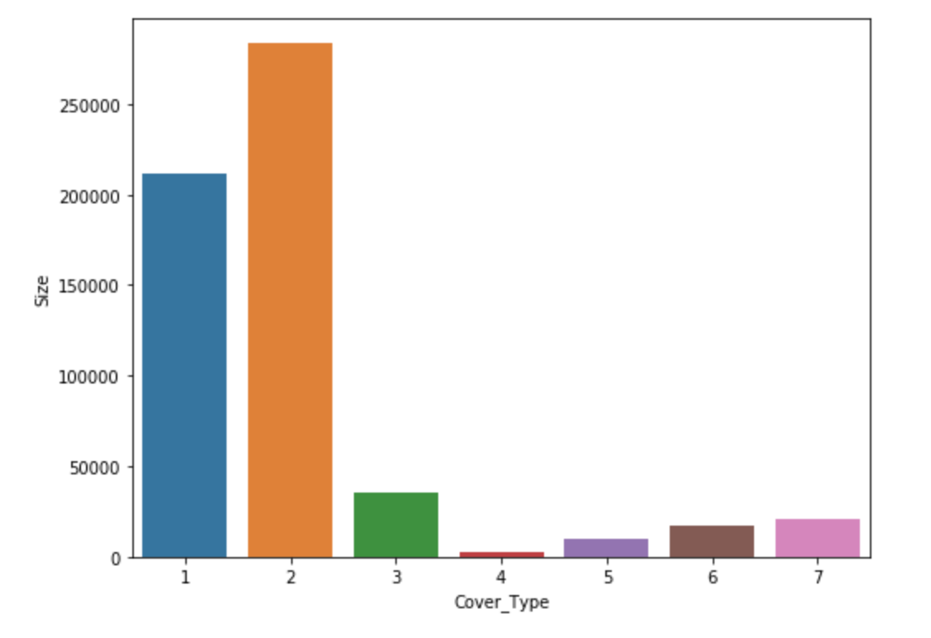
Auxiliary Results: Representation of Cover Type
Top Cover Types in the Data:
Spruce/Fir: 36.46 % of the data.
Lodgepole Pine : 48.76 % of the data.
Ponderose Pine: 6.15 % of the data.

Slide 7
Methodology: Data Exploration and Classification
The data was first explored and described
The most important features were found before every classification
The data was split into a training group and a testing or validation group
Machine learning algorithms were applied to each group
The algorithms were used to separate the cover types of each sample
The best overall model was selected for on certain metrics

Slide 8
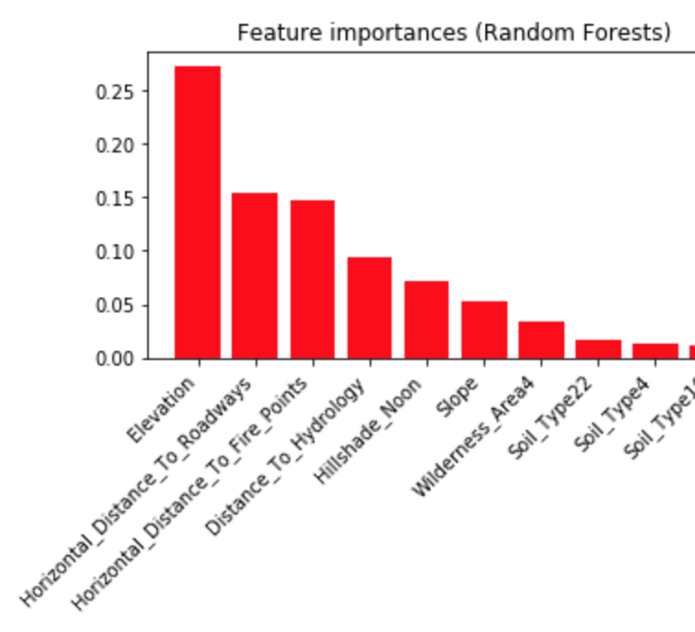
Finding: Elevation, Roadway Distance, Fire Points

Slide 9
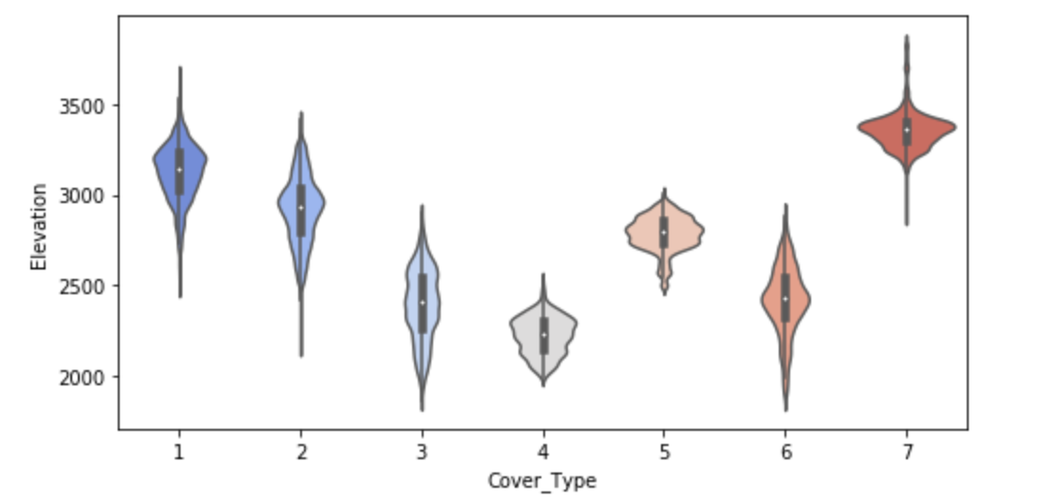
A Closer Look at Elevation

Slide 10
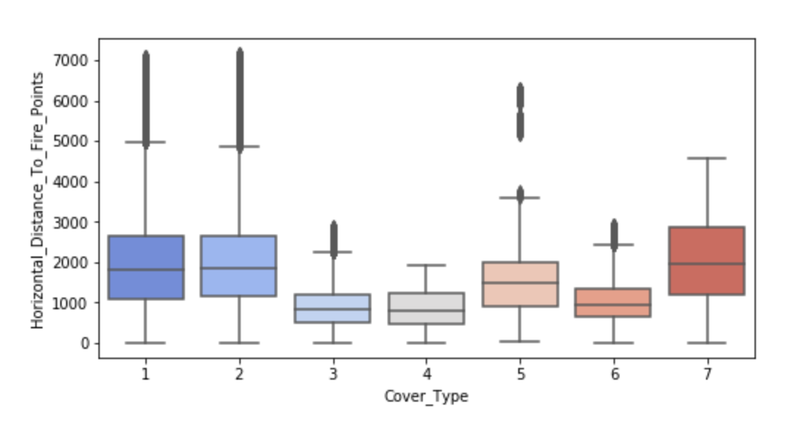
A Closer Look at Fire Point Distance

Slide 11
Recommendations
Consider that these results are best suited for evergreen cover type prediction
When evaluating resources, be sure to look at roadway construction and fire-point safety
Most accurate models suggest elevation and slope are also important factors
May be useful for figuring out if areas are prone to runoff or mudslides given cover type

Slide 12
Future Work
Apply rigorous mathematics to the calculation of distance to fire points and hydrology
No real “Earth” calculations
More information on the history of the landscape
Avalanche and snowfall data
Tourist and other walking type data
Fishing and recreational activities

Slide 13
Thank you for your time.
Are there any questions, comments or concerns?
Sources
Github
UCI Machine Learning Repository
USDA

